Slide 1
SQL Commands

Slide 2
The SELECT Statement
The SELECT clause is a fundamental SQL statement used to retrieve data from a database table.
It allows you to specify which columns you want to retrieve and present in the query result.
You can use an asterisk (*) to select all columns from a table.
SELECT column1, column2, ...
FROM table_name;

Slide 3
Select Statement
You can use aliases to rename columns in the result, making it more readable.
SELECT product_name AS "Product Name", price AS "Price"
FROM products;

Slide 4
Select Statement
Aritmetic Operations:
-- Calculate the total price for each product (price * quantity)
SELECT product_name, price, quantity, price * quantity AS total_price
FROM products;
Functions:
-- Concatenate first_name and last_name with a space in between
SELECT CONCAT(first_name, ' ', last_name) AS full_name
FROM employees;

Slide 5
Functions
COALESCE - Given a list of values, returns the first non-NULL value.
CONCAT - Concatenates all of the values in its argument list.
COUNT - Counts the number of rows passed in.
Link

Slide 6
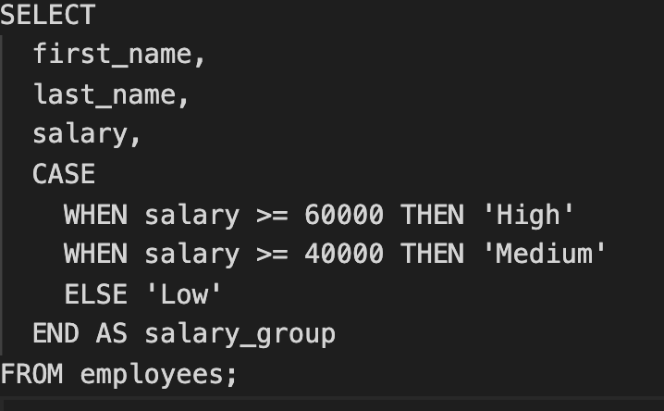
Select Statement
Using a case:

Slide 7
Using joins
-- Retrieve customer information and their associated orders
SELECT customers.customer_name, orders.order_date
FROM customers
INNER JOIN orders ON customers.customer_id = orders.customer_id;

Slide 8
Group by and aggregate functions
-- Count the number of orders for each product category
SELECT product_category, COUNT(*) AS order_count
FROM products
INNER JOIN order_details ON products.product_id = order_details.product_id
GROUP BY product_category;

Slide 9
Using Subqueries
-- Find the employees who are managers
SELECT first_name, last_name
FROM employees
WHERE employee_id IN (
SELECT manager_id
FROM employees
);

Slide 10
The FROM Clause
Basic from:
SELECT column1, column2
FROM table_name;
Multiple tables:
SELECT orders.order_id, orders.order_date, customers.customer_name
FROM orders
INNER JOIN customers ON orders.customer_id = customers.customer_id;

Slide 11
Using table aliases
SELECT column1, column2
FROM table_name AS alias;

Slide 12
The WHERE Clause
Basic syntax:
SELECT column1, column2
FROM table_name
WHERE condition;

Slide 13
Operators
The WHERE clause often uses comparison operators to create conditions.
Examples of common operators: =, >, <, >=, <=, <>
Logical operators (AND, OR, NOT) can be used to combine multiple conditions.
The BETWEEN operator is used to specify a range of values.
The LIKE operator is used for pattern matching, including wildcard characters (% and _).
The IS NULL operator checks for NULL values in a column.
The IS NOT NULL operator checks for non-NULL values.

Slide 14
Examples
SELECT * FROM customers
WHERE last_name = 'Smith';
SELECT * FROM products
WHERE price <> 50;

Slide 15
Examples
SELECT * FROM orders
WHERE order_date BETWEEN '2023-01-01' AND '2023-06-30';
SELECT * FROM products
WHERE product_name LIKE '%apple%';
SELECT * FROM employees
WHERE last_name LIKE 'Sm%';

Slide 16
Examples
SELECT * FROM products
WHERE price < 50 AND stock_quantity > 10;
SELECT * FROM customers
WHERE state NOT IN ('New York', 'California');

Slide 17
JOIN Operations
SELECT columns
FROM table1
JOIN table2 ON table1.column_name = table2.column_name;

Slide 18
The GROUP BY Clause
SELECT column1, aggregate_function(column2)
FROM table_name
GROUP BY column1;

Slide 19
Aggregate functions (e.g., COUNT, SUM, AVG, MAX, MIN) are used within the SELECT statement to summarize data.
Each function serves a different purpose, such as counting rows or calculating the average of numeric values.

Slide 20
The HAVING Clause
The HAVING clause allows you to filter groups based on aggregate function results.
It's used to set conditions for the grouped data, similar to the WHERE clause.

Slide 21
Common SQL Functions: COUNT and SUM
The COUNT() function is used to count the number of rows or values in a column.
The SUM() function calculates the sum of values in a numeric column.
The AVG() function computes the average of numeric values in a column.
The MAX() function returns the highest value in a column.
MIN() Function

